Slide 1
Degree Preserving Graph Summarization
By Jemish Variya and Raj Patel

Slide 2
Introduction
Nowadays extensive scale of data increment, i.e.,
Social media platform
Data driven value adding service
Difficulties in analyzing massive graph
Solution is Graph Summarization

Slide 3
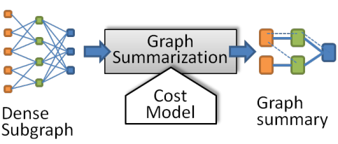
Graph Summarization
For a given graph G, find the summarized graph of G with supernodes as group of related nodes and superedges and group of related edges.
Makes graph easier to process, analyze and understand.
It includes,
Graph Summarization Model
Graph Reconstruction Scheme from summarized graph.

Slide 4
Objective
Summarization models exploits uniform reconstruction scheme for roughly balanced degree graph.
Today real world application graphs are inherently highly degree skewed, there this uniform scheme exhibits errorneous reconstruction.
E.g., user database of a social media plateform. Where celebrities tend to have connections much more than normal users.
So can we distribute edge weights in accordance with the degree of node.

Slide 5
Summarization Methods
Following are the categories of graph summarization methods depending upon the purpose.
Error of Adjacency Matrix
Total Edge Number
Encoding Length

Slide 6
Reconstruction Scheme
Procedure to reconstruct the original graph from the summarized graph.
Many existing summarization model uses the Uniform Reconstruction scheme to reconstruct the graph.
But real world graph database has highly degree skewed nodes.
That creates large differences between original graphs and reconstructed graphs in terms of degrees of nodes and other properties of graph.

Slide 7
DPGS
Assigns superedges proportional to node degrees in original graph.
Uses Minimum Description Length (MDL) to minimize the cost of summary Graph and Reconstruction Error.
It uses Locality Sensitive Hashing (LSH) to group candidate nodes and it merges nodes greedily within the groups.
More efficient yet effective than uniform reconstruction scheme in real world highly skewed graphs.

Slide 8
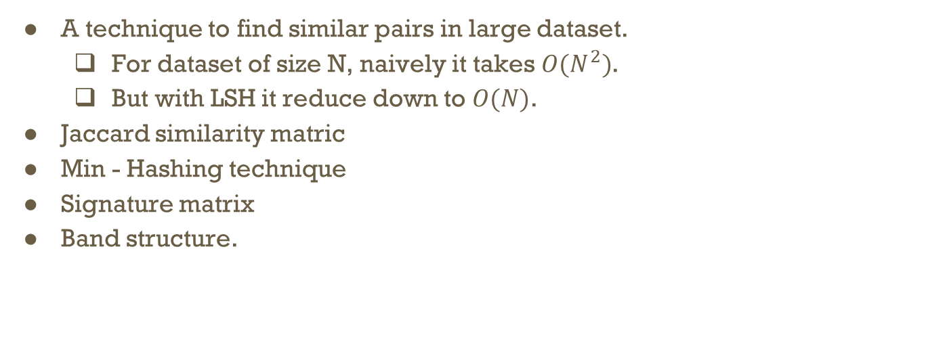
What is LSH?
A technique to find similar pairs in large dataset.
For dataset of size N, naively it takes $O(N^{2})$.
But with LSH it reduce down to $O(N)$.
Jaccard similarity matric
Min - Hashing technique
Signature matrix
Band structure.

Slide 9
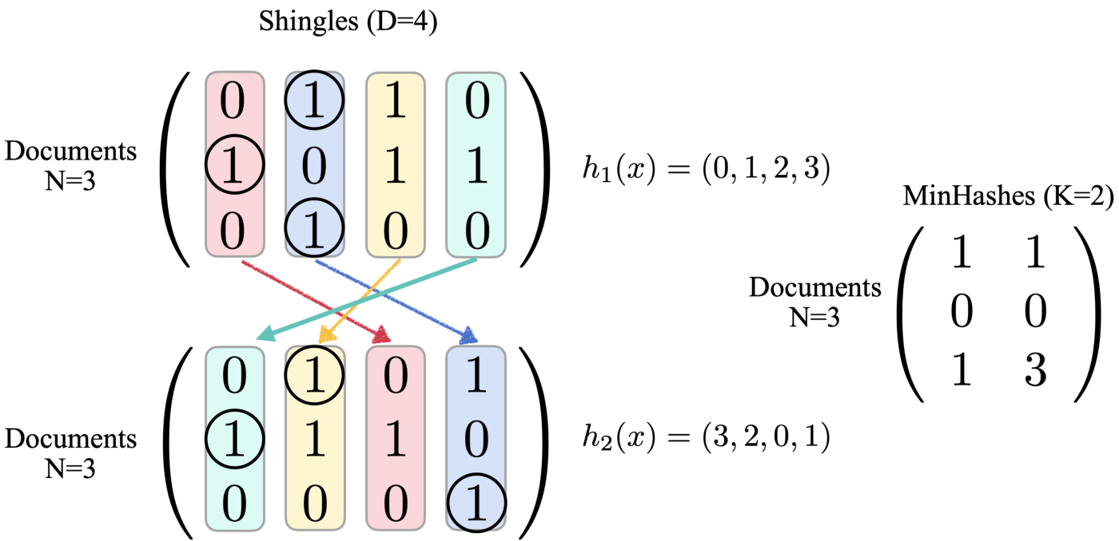

Slide 10
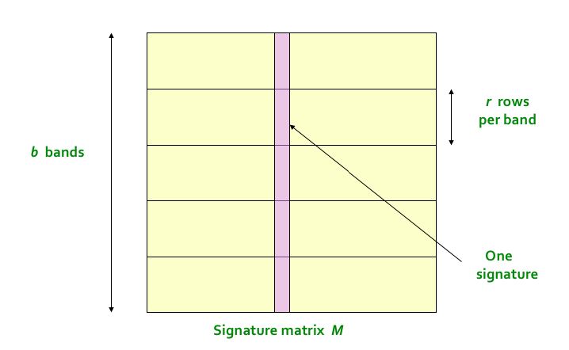

Slide 11
DPGS Summarization
It uses MDL to create summary Graph with minimum error.
Mathematical formulation of Objective Function is given as:
L(M,D) = L(M) + L(D|M)
where, L(M) = Description Length of summary Graph
L(D|M) = Description Length of Errors.

Slide 12
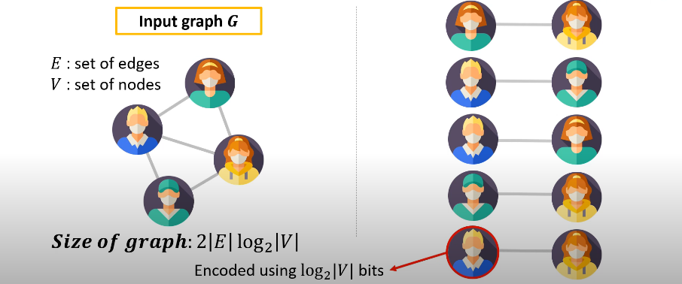
Size of input graph G

Slide 13
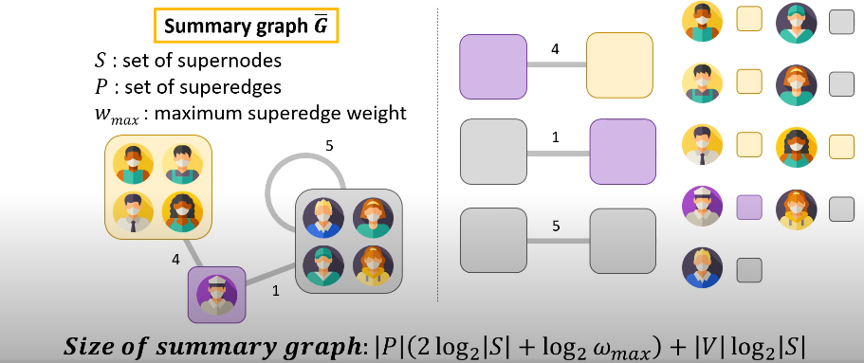

Size of Summary graph $\overline{G}$

Slide 14
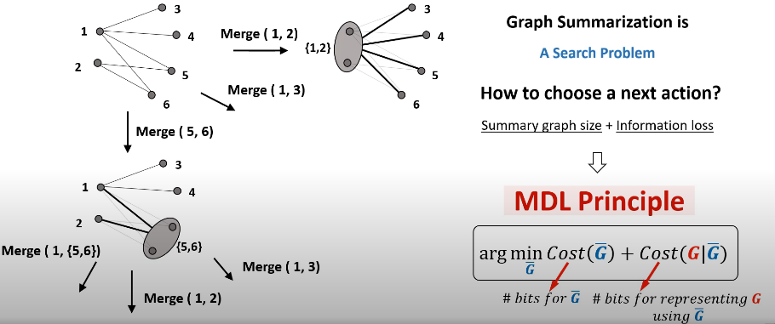
MDL Principle

Slide 15
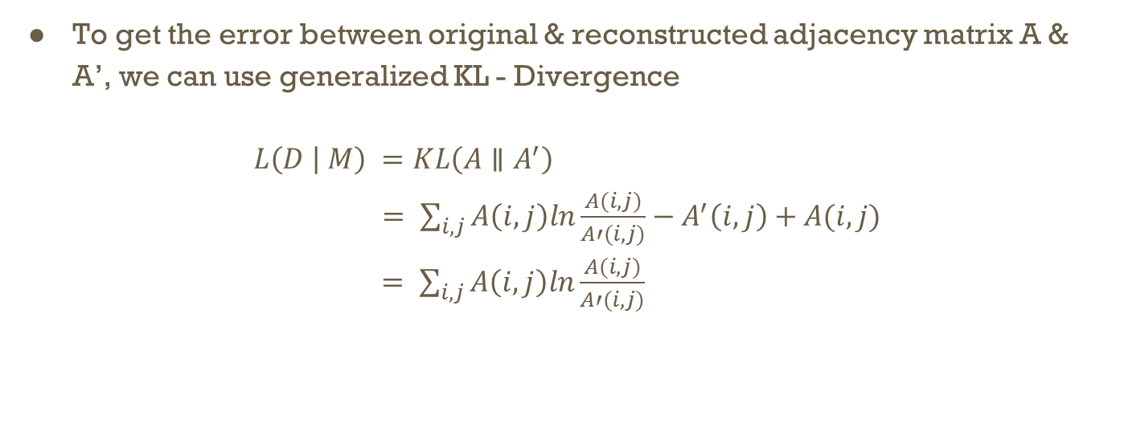
DPGS Summarization
To get the error between original & reconstructed adjacency matrix A & A’, we can use generalized KL - Divergence
$L\left(D | M\right) =KL\left(A∥A^{′}\right)$
$= \sum_{i,j}{A\left(i,j\right)ln\frac{A(i,j)}{A′(i,j)}−A^{′}\left(i,j\right)+A(i,j)}$
$= \sum_{i,j}{A\left(i,j\right)ln\frac{A(i,j)}{A′(i,j)}}$

Slide 16
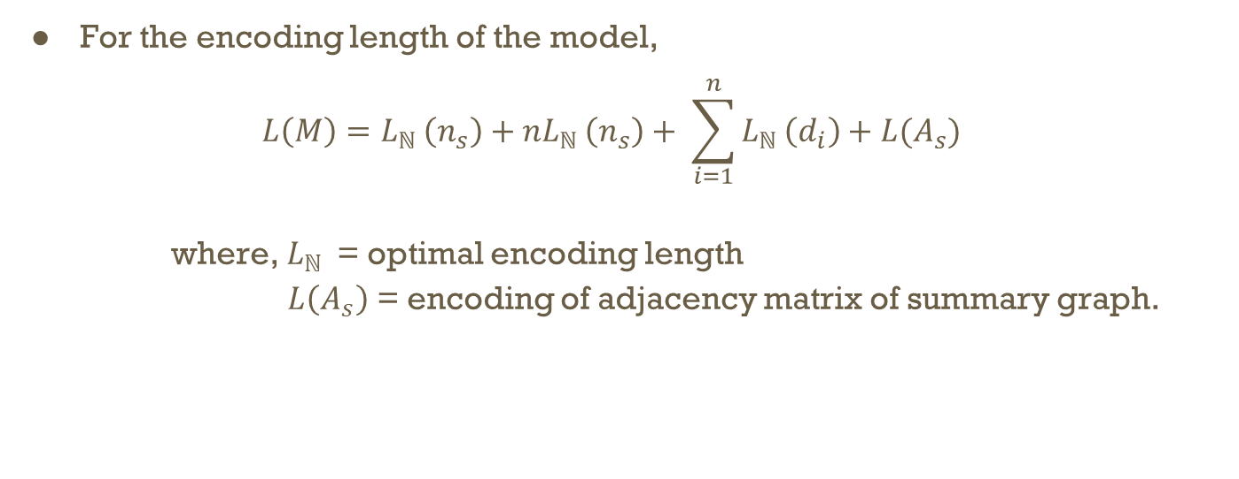
DPGS Summarization
For the encoding length of the model,
$$L\left(M\right)=L_{ℕ }\left(n_{s}\right)+nL_{ℕ }\left(n_{s}\right)+ \sum_{i=1}^{n}{L_{ℕ }\left(d_{i}\right)+L(A_{s})}$$
where, $L_{ℕ }$ = optimal encoding length
$L\left(A_{s}\right)$ = encoding of adjacency matrix of summary graph.

Slide 17
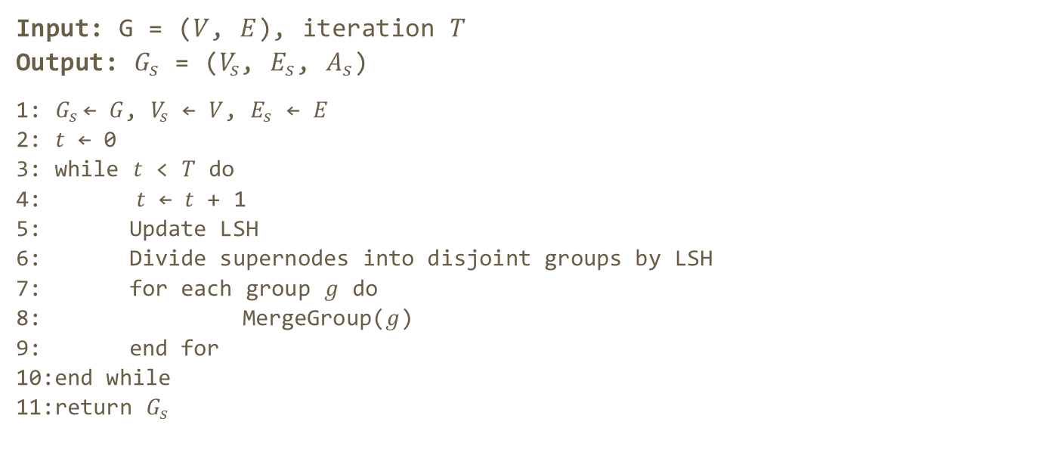
DPGS Algorithm
Input: G = ($V$, $E$), iteration $T$
Output: $G_{s}$ = ($V_{s}$, $E_{s}$, $A_{s}$)
1: $G_{s}$← $G$, $V_{s}$ ← $V$, $E_{s}$ ← $E$
2: $t$ ← 0
3: while $t$ < $T$ do
4: $t$ ← $t$ + 1
5: Update LSH
6: Divide supernodes into disjoint groups by LSH
7: for each group $g$ do
8: MergeGroup($g$)
9: end for
10:end while
11:return $G_{s}$

Slide 18
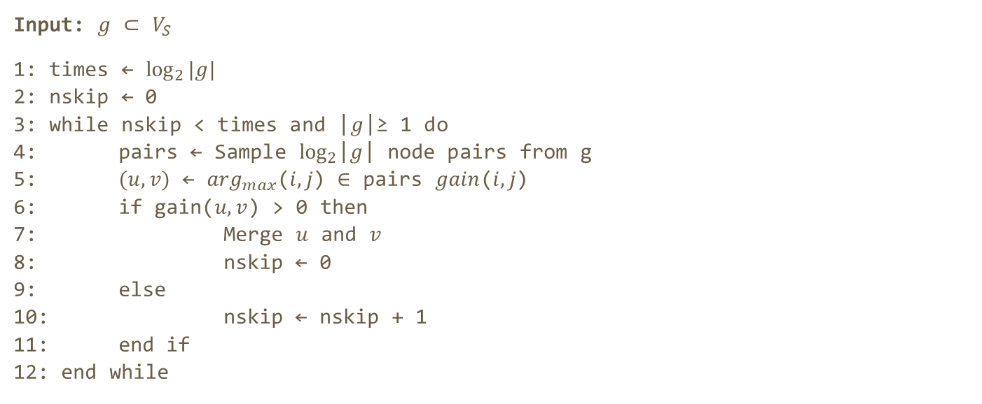
Merge Group Algorithm
Input: $g$ ⊂ $V_{S}$
1: times ← ${log⁡}_{2}|g|$
2: nskip ← 0
3: while nskip < times and |$g$|≥ 1 do
4: pairs ← Sample ${log⁡}_{2}$|$g$| node pairs from g
5: $(u,v)$ ← $\arg_{max}$($i,j$) ∈ pairs $gain$($i,j$)
6: if gain($u,v$) > 0 then
7: Merge $u$ and $v$
8: nskip ← 0
9: else
10: nskip ← nskip + 1
11: end if
12: end while

Slide 19
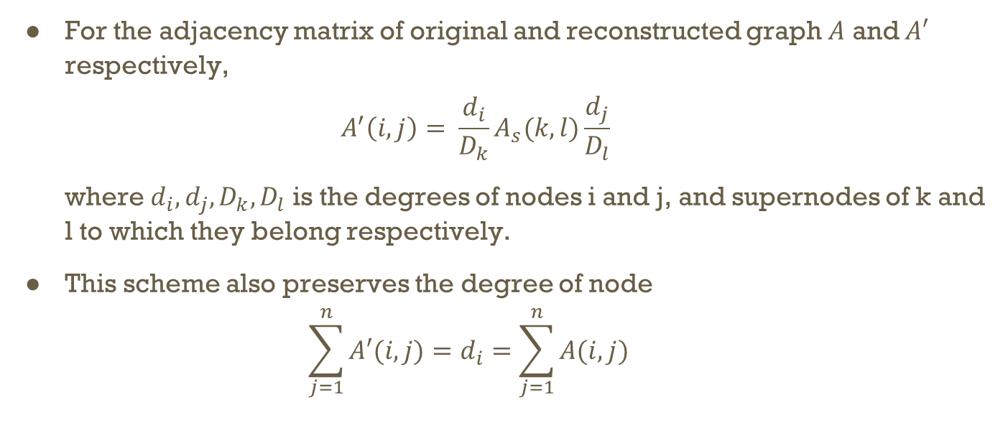
Configuration Based Reconstruction Scheme (CR Scheme)
For the adjacency matrix of original and reconstructed graph $A$ and $A′$ respectively,
$$A^{′}\left(i, j\right)= \frac{d_{i}}{D_{k}}A_{s}(k, l)\frac{d_{j}}{D_{l}}$$
where $d_{i},d_{j},D_{k},D_{l}$ is the degrees of nodes i and j, and supernodes of k and l to which they belong respectively.
This scheme also preserves the degree of node
$$\sum_{j=1}^{n}{A′(i, j)}=d_{i}=\sum_{j=1}^{n}{A(i,j)}$$

Slide 20
Advantages of DPGS
The time complexity of the algorithm is O(T∙|E|).
This algorithm works efficiently in both Uniform and Highly Degree Skewed graphs.
This algorithm can reconstruct the original graph more efficiently and accurately than uniform reconstruction scheme, especially in Degree skewed graphs.
This algorithm can help to train a graph neural network efficiently, while preserving high accuracy in node classification task.

Slide 21
Conclusion
DPGS algorithm is effective and efficient summarization algorithm which bounds perturbation of graph spectrum.
It gives better summary than several state-of-art methods.
It can be used to upgrade summarization models to improve their reconstruction accuracy.
It can be used in training of graph neural networks with less resources without compromising the performance.

Slide 22
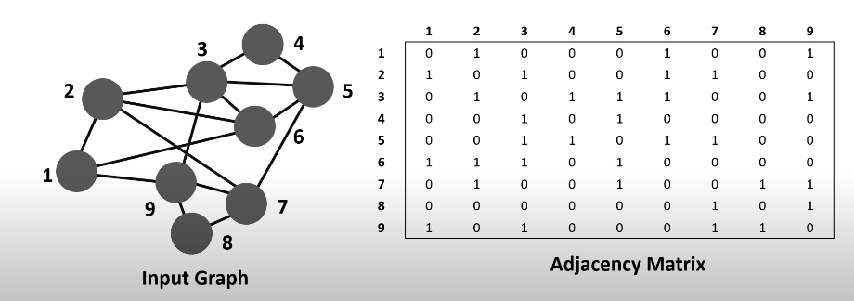
Example

Slide 23
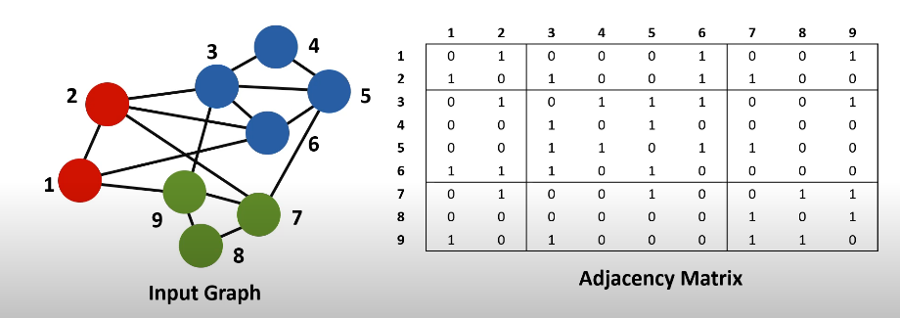
Example

Slide 24
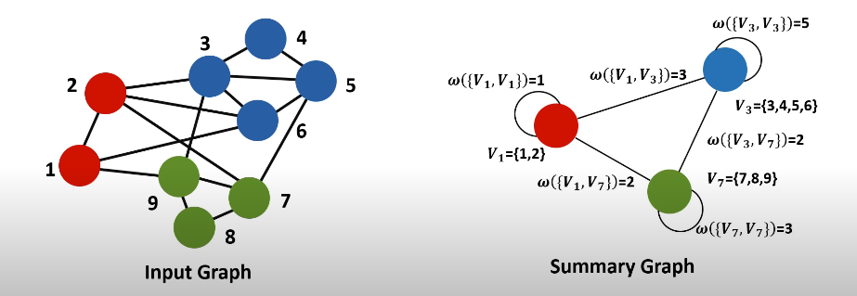
Example

Slide 25
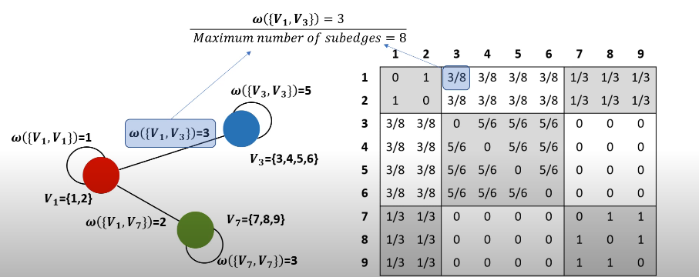
Example

Slide 26
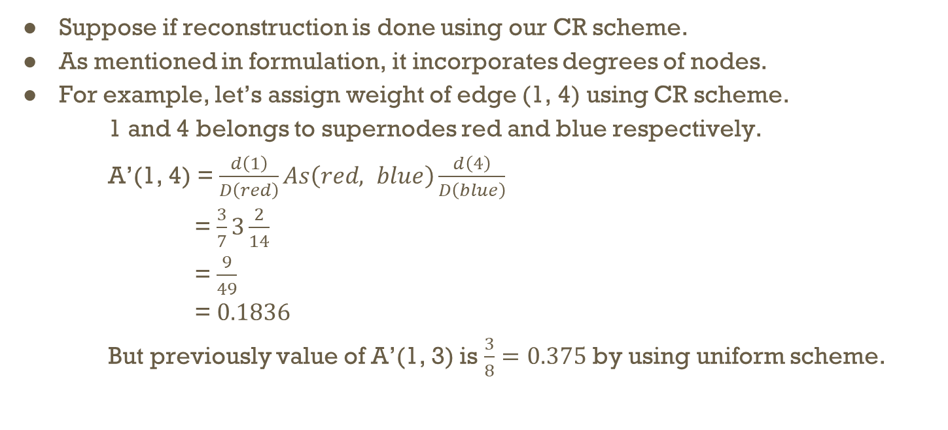
Example
Suppose if reconstruction is done using our CR scheme.
As mentioned in formulation, it incorporates degrees of nodes.
For example, let’s assign weight of edge (1, 4) using CR scheme.
1 and 4 belongs to supernodes red and blue respectively.
A’(1, 4) = $\frac{d\left(1\right)}{D\left(red\right)}As\left(red, blue\right)\frac{d\left(4\right)}{D\left(blue\right)}$
= $\frac{3}{7}3\frac{2}{14}$
= $\frac{9}{49}$
= $0.1836$
But previously value of A’(1, 3) is $\frac{3}{8}=0.375$ by using uniform scheme.

Slide 27
Experimental Analysis
Comparison of reconstruction schemes
Degree distribution with parameter α = 3.0, 3.5, 4.0. Improvement is very high for more skewed graphs(high α value).
Effectiveness
Achieves 28% less description length
Compatibility
Summarization models upgraded with CR scheme achieves more accurate results.
Training GNNs on Summary Graphs
Without sacrificing performance GNNs, we can reduce running time and memory by summarizing the graphs.
Scalability
DPGS algorithm scales linearly with the number of edges.

Slide 28
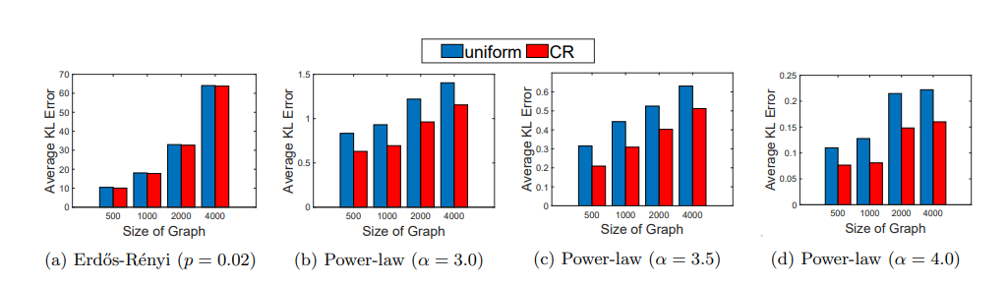
Experimental Results [1]

Slide 29
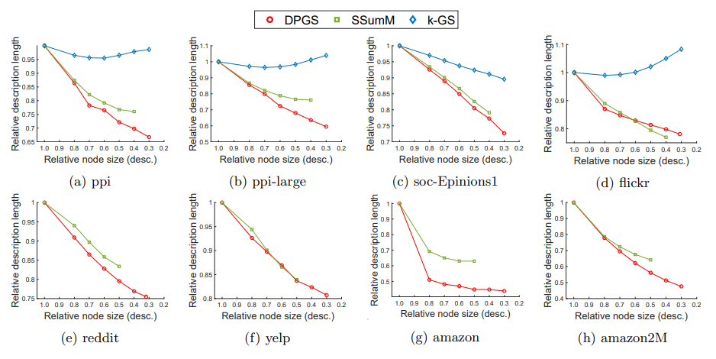
Experimental Results [2]

Slide 30
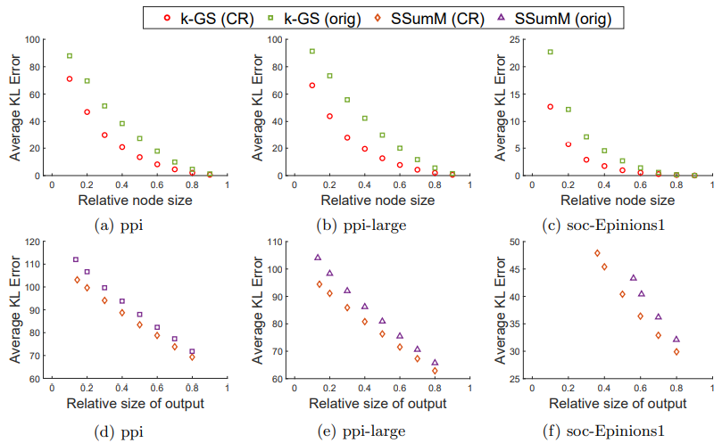
Experimental Results [3]

Slide 31
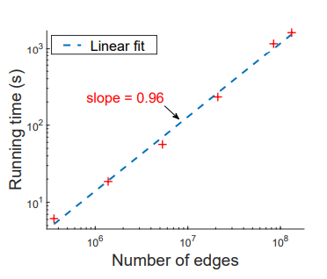
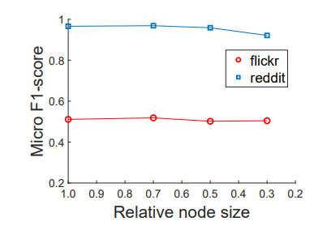
Experimental Results[4] & [5]

